Slide 1
Reducing the Number of Test Cases

Slide 2

Reducing the number of Test Cases
The true art of testing is to select a meaningful subset of test cases that are most likely to uncover problems, thereby reducing total number of tests, while maintaining the confidence in the product.

Slide 3

Prioritization Guidelines
Focus on prioritizing the existing set of test cases.
  The goal of prioritization of test cases is to reduce the set of test cases based on some criteria, while aiming to select the most appropriate tests.
The main guide for selecting test cases is to assess the risk first.
  What are the consequences if some features are not tested?

Slide 4
Priority Category Scheme
Most simplest scheme for categorizing test cases.
Assign a priority code to each test description.
Based on Comparison “Is test X more important than test Y?”

Slide 5
3 Level Priority Categorization Scheme
Priority 1: This test must be executed
Priority 2: If time permits, execute this test.
Priority 3: If this test is not executed, the team won’t be upset

Slide 6
Second Priority Categorization Scheme
Priority 1a: This test must pass, otherwise the delivery will be out of date.
Priority 2a: This test must be executed prior to delivery.
Priority 3a: If time permits, execute this test.
Priority 4a: This test can wait until the next release or shortly after the delivery date.
Priority 5a: Probably never execute this test.

Slide 7
Priority Category Scheme
Once priority codes have been assigned, the tester estimates the amount of time required to execute the tests selected in each category.
If the time estimate falls within the allotted schedule, then the partitioning exercise is completed, otherwise, further partitioning is required.

Slide 8
Risk Analysis
Testing takes time and requires resources
It makes sense to test most rigorously where the risks are greatest
But an intuitive approach to risk is not sufficient
An understanding of both testing and risk is required
Risk Analysis is a well defined process that prioritizes modules for testing.

Slide 9

Components of Risk
Contains two components:
  Probability of occurrence (fault likelihood)
  Severity of impact (failure impact)

Slide 10
Risk Analysis and Testing
Test Plan
Test Item Tree
Risk Strategy
Risk Identification
Testing, Inspection etc.
Risk Assessment
Matrix: Cost and Probability
Risk Mitigation
Test Metrics
Risk Reporting
Risk Prediction

Slide 11
Risk Analysis Table for a Sample System
Problem ID | Potential Problem | Probability of occurrence | Severity of impact | Risk Exposure
A | Loss of Power | 1 | 10 | 10
B | Corrupted file header | 2 | 1 | 2
C | Unauthorized user gains access | 6 | 8 | 48
D | Databases not synchronized | 3 | 5 | 15
E | Unclear user documentation | 9 | 1 | 9
F | Lost sales | 1 | 8 | 8
G | Slow throughput | 5 | 3 | 15
Note – The higher the risk exposure product, the more important it is to test for that condition.

Slide 12
Risk Matrix
Allows the tester to evaluate and rank potential problem by giving more weight to the probability or severity value as necessary.
Use of risk matrix disregards the risk exposure.
The tester uses the Risk Matrix to assign thresholds that classify the potential problems into priority categories.

Slide 13
Risk Matrix
Typically, it contains 4 quadrants
10
A
F
C
Priority 2
Priority 1
D
Severity
G
Priority 4
Priority 3
E
B
1
1
10
Probability

Slide 14
Risk Matrix
Priority 1: High Severity and High Probability
Priority 2: High Severity and Low Probability
Priority 3: Low Severity and High Probability
Priority 4: Low Severity and Low Probability
NOTE – Risk with high severity is deemed more important
than a problem with high probability.

Slide 15
REDUCING THE RISKS PRIOR TO TESTING
Testing on its own does not reduce risks
Testing and correction may not reduce some risks adequately
Better to reduce the risks during development, e.g. by:
  Improving development management
  Improving tester-developer relationships
  Making contracts between developers and testers Etc.
Apply risk-based-testing approach in planning development

Slide 16
Risk Based Testing - Approach
Plan: Identify Elements to be Tested
  Logical or physical Functions, Modules etc.
Identify Risk Indicators
  What is important to predict the probability of faults?
Identify Cost of faults
Identify Critical Elements
  i.e. functions, tasks, activities etc. based on Risk Analysis (Indicators and Cost)
Execute: Improve the Test Process and Organization: Schedule and Track

Slide 17

Risk Based Testing - Metrics
Identify Areas with “High Risk Exposure”
  Probability and Cost
All functions/modules should be tested to a “minimum level”
“Extra Testing” in areas with high risk exposure
Establish Test Plan and Schedule
  Monitor Quality
    Number of Faults per function and time
  Monitor Progress
    Number of hours in test and fix

Slide 18
Benefits of Risk Based Testing
Improved Quality
  all critical functions tested
Reduced Time and Money in Testing
  effort not wasted on non critical or low risk functions
Improved customer confidence
  due to customer involvement and good reporting and progress tracking

Slide 19
Regression testing
Regression testing is an important component of incremental testing. When a new increment is added to the system, the tests which have been run on the previous increment are run again.
If these tests do not produce the same outputs as before, this implies that the new increment has, in some way, interfered with the functionality of the existing system
Notes:
Regression testing is essential and should be the first test activity when a new increment is added to a system.
Regression testing involves taking the tests which were run on the previous increment, re-running them on the new increment and comparing (automatically wherever possible) the test results. If there are differences which are unexpected this implies that there is some unforseen interaction between the previous increment and the added sub-system which has (somehow) affected the behaviour of the previous increment.
This should be examined and repaired before further testing is carried out.

Slide 20
Regression testing
Regression testing is the execution of the collection of test cases on a program in order to ensure that its revision does not produce unintended faults, does not "regress" - that is, become less effective than it has been in the past.
Regression testing is the process of retesting the modified parts of the software and ensuring that no new errors have been introduced into previously tested code.

Slide 21
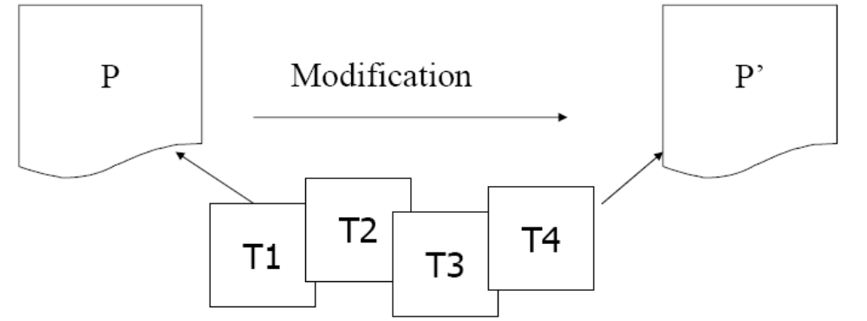
Regression testing
Problem (Rothermel et al):
Given program P, its modified version P’, and a test set T that was used to previously test P, find a way to utilize T to gain sufficient confidence in the correctness of P’

Slide 22
Purpose
Increase confidence in the correctness of modified program
Locate errors in the modified program
Preserve the quality and reliability of S/W
Ensure the software continued operation.

Slide 23
Regression Test Prioritization
Order the execution of a regression test suite so that the “best” tests run first
Prioritize based on code coverage, fault-exposing potential, etc.
Hopefully, defects are revealed earlier in the regression testing process

Slide 24
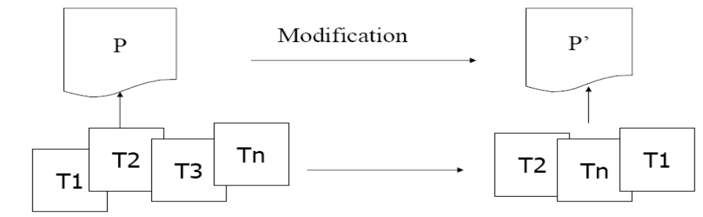
Selection and Prioritization
These two techniques can be used in isolation or in conjunction
This represents an advanced, but possibly incomplete, solution to regression testing problem

Slide 25
Difference between Regression Testing and Development Testing
Development Testing
Regression Testing
We create test suite and test plan.
We can make use of existing test suite
and test plan
We test all S/W components.
We test modified components or
components affected by modification.
Budget gives time for testing.
No time (performed in crisis situation)
Once on S/W product
Many times

Slide 26
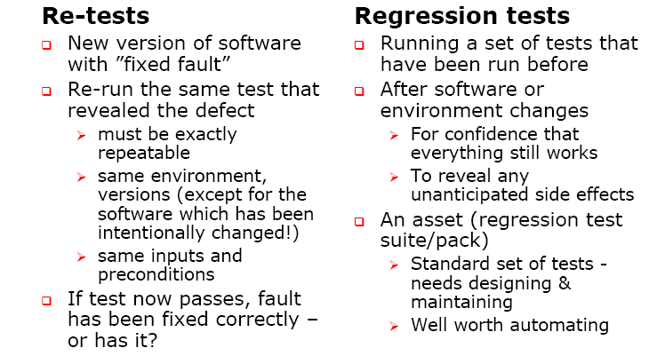
Re-testing vs. Regression testing

Slide 27
Types of Regression Testing
Corrective Regression Testing
Progressive Regression Testing
Retest all Regression Testing
Selective Regression Testing

Slide 28
Corrective Regression Testing
Corrective Regression Testing applies when specifications are unmodified and test cases can be reused.

Slide 29
Progressive Regression Testing
Progressive Regression Testing applies when specifications are modified and new test cases must be designed.

Slide 30
The Retest-All Strategy
The retest-all strategy reuses all tests, but this strategy may waste time and resources due to execution of unnecessary tests.
When the change to a system is minor, this strategy would be rather wasteful.

Slide 31
The Selective Strategy
Uses a subset of the existing test cases to reduce the retesting cost.
In this strategy, a test unit must be rerun if and only if any of the program entities, eg. Functions, variables, etc. have been changed.
The challenge is to identify the dependencies between a test case and the program entities it covers.

Slide 32
Selective Strategy Process
Identify affected software components after program P, has been modified to P’.
Select a subset of test cases, T’, from an existing test suite, T that covers the software components that are affected by the modification.
Test modified program P’ with T’ to establish the correctness of P’ with respect to T’.
Examine test results to identify failures.
Identify and correct the faults that caused a failure.
Update the test suite and test history for P’.

Slide 33
Characteristics of Selective Strategy Process
Identifying the program components that must be retested and finding those existing tests that must be rerun are essential.
When selected test cases satisfy retest criterion, new test cases are not needed.
Once regression testing is done, it is necessary to update and store the test information for reuse at a later time.

Slide 34
Prioritization of Test Cases for Regression Testing
Test case prioritization involves scheduling test cases in an order that increases their effectiveness in meeting some performance goals.
Test suit minimization techniques lower costs by reducing a test suite to a minimal subset that maintains equivalent coverage of original set with respect to particular test adequacy criterion.

Slide 35
Test Case Prioritization Methods
General Test Case Prioritization – For a given program, P, and test suite T, we prioritize the test cases in T that will be useful over a succession of subsequent modified version of P without any knowledge of modified version.
Version specific test case prioritization – Prioritize the test cases in T, when P is modified to P’, with the knowledge of the changes that have been made in P.
We consider the version specific regression test selection algorithm whose objective is to execute the modified lines of code with maximum number of test cases.

Slide 36
Example
Let P be a procedure or program. P’ be a modified version of P. T be a set of code coverage based tests created to test P.
When P is modified to P’, we have to find T’, which is a subset of T that achieves maximum code coverage at the earliest and should be given highest priority during regression testing. Thus, identify the tests that:
a) Execute the code that has been deleted so that test cases that have gone redundant can be deleted from T.
b) Execute modified code at least once at the earliest.
Consider a hypothetical program of 60 lines of code. There are 10 code coverage based test cases.

Slide 37
Execution History
Test Case no | Execution History
T1 | 1, 2, 20, 30, 40, 50
T2 | 1, 3, 4, 21, 31, 41,51
T3 | 5, 6, 7, 8, 22, 32, 42, 52
T4 | 6, 9, 10, 23, 24, 33, 43, 54
T5 | 5,9,11,12,13,14,15,20,29,37,38,39
T6 | 15,16,17,18,19,23,24,25,34,35,36
T7 | 26,27,28,40,41,44,45,46
T8 | 46,47,48,49,50,53,55
T9 | 55,56,57,58,59
T10 | 3,4,60

Slide 38
Test Case Array
Suppose the lines 1, 2,5,15,35,45,55 are modified
Simplest is to execute all the test cases that have any of the modified line of code.
Selected test cases:- T1, T2, T3, T5, T6, T7, T8, T9
Total = 8 test cases

Slide 39
Test case | Modified Lines | No. of Matches
T1 | 1, 2 | 2
T2 | 1 | 1
T3 | 5 | 1
T5 | 5,15 | 2
T6 | 15,35 | 2
T7 | 45 | 1
T8 | 55 | 1
T9 | 55 | 1

Slide 40
Version Specific Test Case Prioritization Contd…
No. of matches found (N Found) is stored in an array & elements are stored in descending order.
The test case that has the maximum number of matches is selected by making its candidate value = 1. This test case will be selected first and is shown in next slide.

Slide 41
Test cases | No. of matches found | Line Number | Candidate
T1 | 2 | 1,2 | 1
T5 | 2 | 5,15 | 0
T6 | 2 | 15,35 | 0
T2 | 1 | 1 | 0
T3 | 1 | 5 | 0
T7 | 1 | 45 | 0
T8 | 1 | 55 | 0
T9 | 1 | 55 | 0
Selected for
Execution
Removed as
Selected for
execution
LOC that are still to be executed are – [5, 15, 35, 45, 55]

Slide 42
Version Specific Test Case Prioritization Contd…
T1 is elected for execution & it covers lines no 1&2 so the modified lines are 5,15,35,45,55.
Again we check the number of modified lines of code covered by each test cases and sort them in descending order and select the one with maximum number of Matches

Slide 43
Test case | Modified Lines | No. of Matches
T3 | 5 | 1
T5 | 5,15 | 2
T6 | 15,35 | 2
T7 | 45 | 1
T8 | 55 | 1
T9 | 55 | 1

Slide 44
Test cases | No. of matches found | Line Number | Candidate
T5 | 2 | 5,15 | 1
T6 | 2 | 15,35 | 0
T3 | 1 | 5 | 0
T7 | 1 | 45 | 0
T8 | 1 | 55 | 0
T9 | 1 | 55 | 0
Selected for
Execution
Removed
as selected
for execution
LOC that are still to be executed are – [35, 45, 55]

Slide 45
Test case | Modified Lines | No. of Matches
T6 | 15,35 | 2
T7 | 45 | 1
T8 | 55 | 1
T9 | 55 | 1

Slide 46
Test cases | No. of matches found | Line Number | Candidate
T6 | 1 | 35 | 1
T7 | 1 | 45 | 1
T8 | 1 | 55 | 1
T9 | 1 | 55 | 0
Selected for
Execution
Duplicate
LOC that are still to be executed are – [45, 55]

Slide 47
Version Specific Test Case Prioritization Contd…
Test Cases selected are:-
T1, T5, T6, T7, T8
Modification traversing test cases were 8 but for 100% code coverage for modified lines 5 test cases are required.

Slide 48
Second Case
Lines of code have been modified and also deleted.
For addition of lines we have to write new test cases.
Example: 20 lines of code
5 test cases

Slide 49
Execution History
Test case | Execution History
T1 | 1, 5, 7, 15, 20
T2 | 2, 3, 4, 5, 8, 16, 20
T3 | 6, 8, 9, 10, 11, 12, 13, 14, 17, 18
T4 | 1, 2, 5, 8, 17, 19
T5 | 1, 2, 6, 8, 9, 13

Slide 50
Second Case
Modified Lines:- 6, 13, 17, 20
Deleted Line: 4, 7, 15
Modified Execution History
Test case | Modified Execution History
T1 | 1, 5, 20
T2 | 2, 3, 5, 8, 16, 20
T3 | Same as previous 6, 8, 9, 10, 11, 12, 13, 14, 17, 18
T4 | 1, 2, 5, 8, 17, 19
T5 | 1, 2, 6, 8, 9, 13

Slide 51
Second Case
T1 and T5 are redundant test cases
Identify redundant test cases.
If we see the execution history carefully we come to know that T1, T5 are redundant test cases

Slide 52
Test cases | Line Number of LOC | Found in Test Case | Redundant (Y/N)
T1 | 1 5 20 | T4 T2 T2 | Y Y Y
T5 | 1 2 6 8 9 13 | T4 T2 T3 T3 T3 T3 | Y Y Y Y Y Y

Slide 53
Second Cases
The remaining test cases are T2, T3, T4
Modified LOC are [6, 13, 17, 20]
Test case | Modified Line | No of matches
T2 | 20 | 1
T3 | 6, 13, 17 | 3
T4 | 17 | 1

Slide 54
Second Case
Test cases are sorted in descending order of No. of matches
T3 is selected for execution remaining line is 20.
Hence T3 and T2 are sufficient to execute modified lines.
Test case | No of matches | lines | Candidate
T3 | 3 | 6, 13, 17 | 1
T2 | 1 | 20 | 0
T4 | 1 | 17 | 0

